Slide 1
DATA 6500
Title :
Spatial Analysis Ponderosa Pine Tree Point Pattern
Professor:
Dr.Julie Horrocks
Student:
Mohsen Selseleh
Student No: 1207477 Summer 2022

Slide 2
Outline
Introduction
Past works
Statement of research
Images Ponderosa Pine Tree and the map of the Klamath National Forest
Information on Data set
Plotting data
Statistical Methods(F,G,L,K tests) and ppm Model
Conclusion and Future Work

Slide 3
Introduction
Study Ponderosa pine forests is significant because they are very important for lumber/wood and for surviving ecosystem specially in the Southwest of USA. Unfortunately, this precious tree is at risk because of climate changes, wildfire droughts, and insects .This Study could be suitable technique in finding locations, the distribution patterns, and relationships in Ponderosa pine forests.

Slide 4
Past researches
Reich et al (1991) used Distance-based multiresponse for studying Spatial analysis of ponderosa pine trees infected with dwarf mistletoe.
Boyden et al(2005) assessed spatial and temporal patterns of tree establishment, mortality and size structure over a 30-year period in an old-growth ponderosa pine stand in the mid-montane zone of the Colorado Front Range. They analyzed spatial patterns and spatial associations using Ripley's K(t) and K12(t) and then modeled the patterns using point process models.
Haire & McGarigal(2010)To determine how spatial characteristics influence the process of ponderosa pine regeneration under this new regime, they mapped the spatial patterns of severity at areas that burned in 1960.

Slide 5
Statement of research
The aim of this study is understanding and finding the distribution patterns of Ponderosa pine trees.
I will provide Data set description, the intensity of the process Statistical Methods as F, G, K, L and Model (Nonstationary Poisson process)(Horrocks,2022).

Slide 6
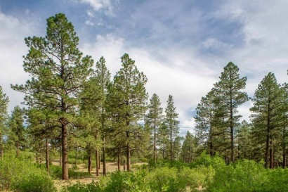
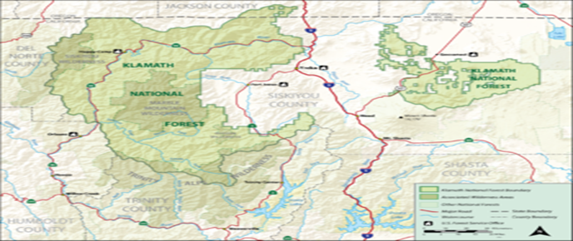
Image: Ponderosa Pine Tree and the map of the Klamath National Forest

Slide 7
Information on Data set
Ponderosa data set
Data description:
locations of 108 ponderosa pine trees in a square whose physical size is 14400 square metres

Slide 8
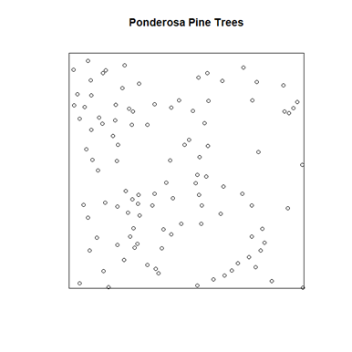
Plotting data

Slide 9
Statistical Methods and Model
The purpose of a statistical analysis is to learn about the true/underlying process that generated the data, and not just the particular data that you have(Horrocks,2022)

Slide 10
Results
Intensity and Unit of Measurement:
Intensity in a homogeneous process equal: n/a
Intensity = 108
Unit of measurement: 108/120*120 = 0.0075 points per square metre

Slide 11
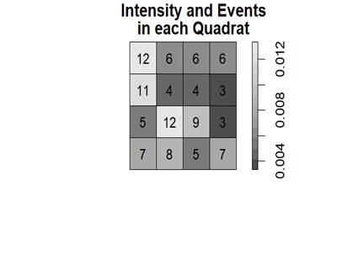
Quadrats:
The number of events in each of 4 quadrats

Slide 12
Quadrat Test:
Chi-squared test of CSR using quadrat counts
data: ponderosa
X2 = 19, df = 15, p-value = 0.4
H0: The ponderosa pine trees distribution is complete spatial randomness (CSR) Ha: The ponderosa pine trees distribution is not complete spatial randomness
H0 is not rejected because P-value is not small. It seams that process is homogeneous pp or CSR.

Slide 13
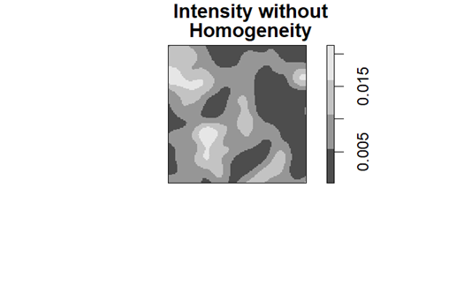
Inhomogenous Poisson Process: In most cases assuming that a point process under study is homogenous is not realistic. IPP is a generalisation of the HPP.
Intensity without Homogeneity
Intensity is highest near the clusters and lowest near the empty spaces.

Slide 14
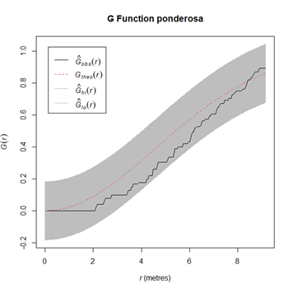
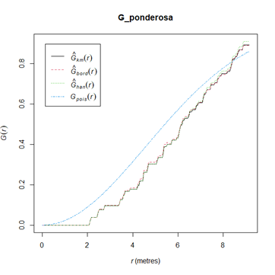
G-test H0 is not rejected therefore it is not CSR, because the stepped line (G function for the data) falls inside the envelope, then the null hypothesis of CSR is not rejected.

Slide 15
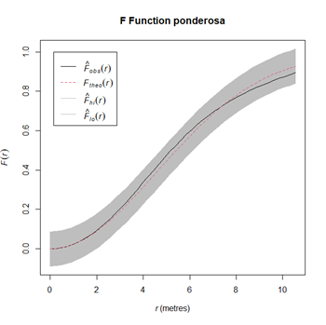
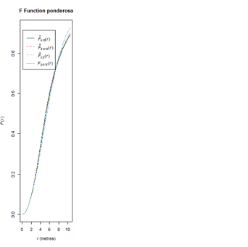
Fest :looks is CSR (H0 is not rejected), because black curve is in the enveloped area.

Slide 16
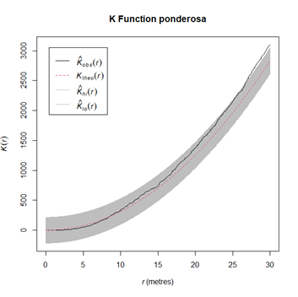
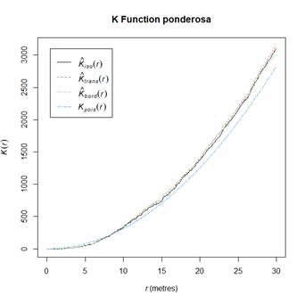
K test:The majority of black curve is in the envelope; therefore, it is not clustered. K test has a big value. Second-order properties are particularly interesting if we are keen studying clustering or competition between events.

Slide 17
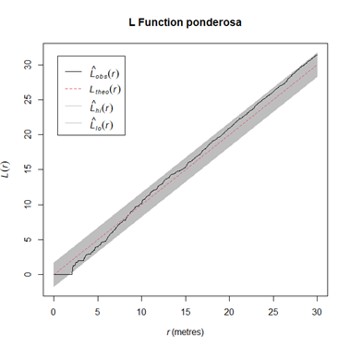
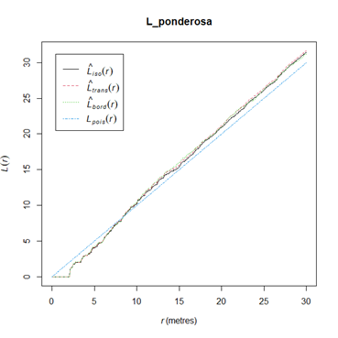
L test, H0 is not rejected (It is CSR), because black line is located in the enveloped area

Slide 18
Ppm model The result does not show any trend.
Nonstationary Poisson process
Log intensity: ~x + y + I(x^2) + I(y^2) + I(x * y)
Fitted trend coefficients:
(Intercept) x y I(x^2) I(y^2) I(x * y)
-4.91e+00 6.08e-03 6.67e-03 -6.21e-05 -1.83e-05 -1.15e-04
Estimate S.E. CI95.lo CI95.hi Ztest Zval
(Intercept) -4.91e+00 4.92e-01 -5.873922 -3.95e+00 *** -9.987
x 6.08e-03 1.25e-02 -0.018475 3.06e-02 0.486
y 6.67e-03 1.24e-02 -0.017674 3.10e-02 0.537
I(x^2) -6.21e-05 9.40e-05 -0.000246 1.22e-04 -0.661
I(y^2) -1.83e-05 9.08e-05 -0.000196 1.60e-04 -0.201
I(x * y) -1.15e-04 8.63e-05 -0.000284 5.46e-05 -1.327

Slide 19
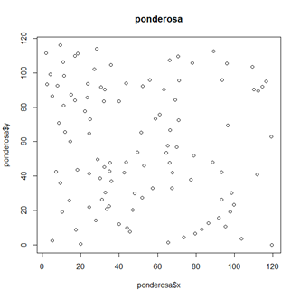

Slide 20
Parasimonious Model:The result does not show any trend
Nonstationary Poisson process
Log intensity: ~x + y + I (x * y)
Fitted trend coefficients:
(Intercept) x y I(x * y)
-4.716299 -0.001398 0.004069 -0.000106
Estimate S.E. CI95.lo CI95.hi Ztest Zval
(Intercept) -4.716299 3.53e-01 -5.409128 -4.02e+00 *** -13.342
x -0.001398 5.47e-03 -0.012121 9.32e-03 -0.256
y 0.004069 5.01e-03 -0.005744 1.39e-02 0.813
I(x * y) -0.000106 8.19e-05 -0.000266 5.45e-05 -1.294

Slide 21
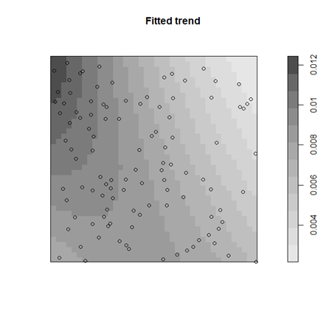
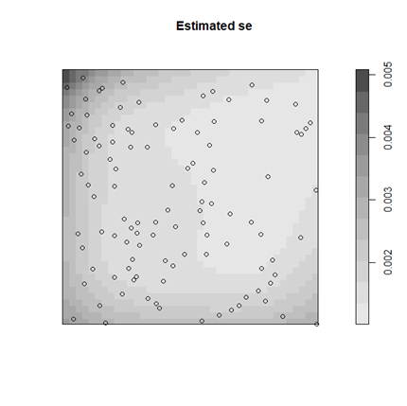

Slide 22
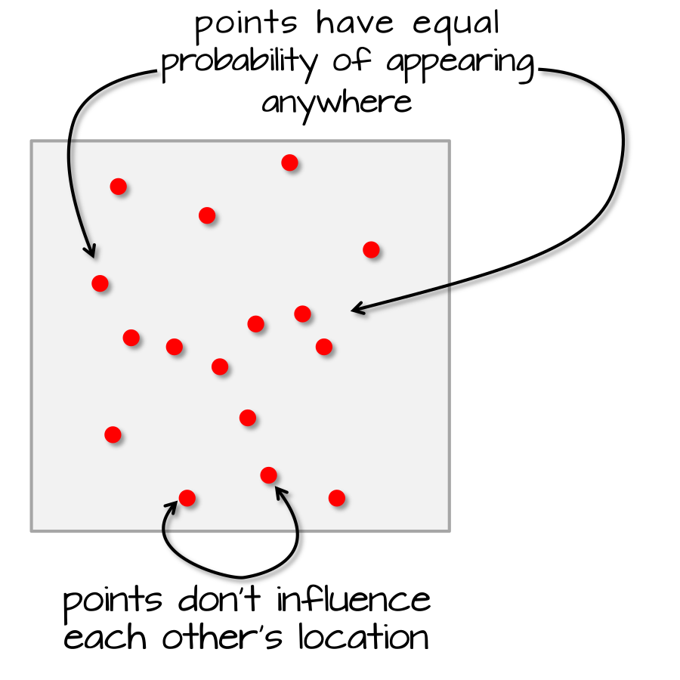
Therefore ,We could conclude that Ponderosa dataset is complete spatial randomness (CSR). CSR/IRP satisfy two conditions:
Any event has equal probability of occurring in any location, a 1st order effect.
The location of one event is independent of the location of another event, a 2nd order effect.

Slide 23
Conclusion and Future Work
The results reveals that underlying process of the distribution of Ponderosa tree is Complete spatial randomness (CSR) with estimated intensity equals with 0.0075. I fit a ppm model with functions of x and y coordinates as the covariate that is the trend surface model. For future researches, I suggest that spatial analysis studies will be done on ponderosa pine trees which are infected with insects ,wildfire and droughts.

Slide 24
Reference
Bivand, R. S., Pebesma, E. J., Gómez-Rubio, V., & Pebesma, E. J. (2008). Applied spatial data analysis with R (Vol. 747248717, pp. 237-268). New York: Springer.
Horrocks, J. (2022) Analyse of Spatial-Temporal Data [Course notes]. Retrieved from https://courselink.uoguelph.ca/d2l/home/758284
Haire, S.L., McGarigal, K. Effects of landscape patterns of fire severity on regenerating ponderosa pine forests (Pinus ponderosa) in New Mexico and Arizona, USA. Landscape Ecol 25, 1055–1069 (2010). https://doi.org/10.1007/s10980-010-9480-3
Gimond,M(2022) Intro to GIS and Spatial Analysis,https://mgimond.github.io/Spatial/index.html
Reich, R. M., Mielke Jr, P. W., & Hawksworth, F. G. (1991). Spatial analysis of ponderosa pine trees infected with dwarf mistletoe. Canadian Journal of Forest Research, 21(12), 1808-1815.
R Core Team (2022). R: A language and environment for statistical computing. R Foundation for Statistical Computing, Vienna, Austria. URL: https://www.R-project.org
Rstudio, 2022.07.0 Build 548,© 2009-2022 RStudio, PBC(I used this version Of R)

Slide 25
Thanks a lot of your consideration
I should appreciate Professor Horrocks who with her helps I could continue and finish assignments and project.
I should appreciate of my great classmates who helps me in this course
Mr Noah helps me in GIS ,Mr Mohsen Kassiri lots of time share his computer with me and explained for me,As Mr Sean who generously always ready to help and Ms Anderson who gives us information about R workshops which were so helpful .Thanks to all of you!
This class was so interesting and I learned lots of things.

